Slide 1
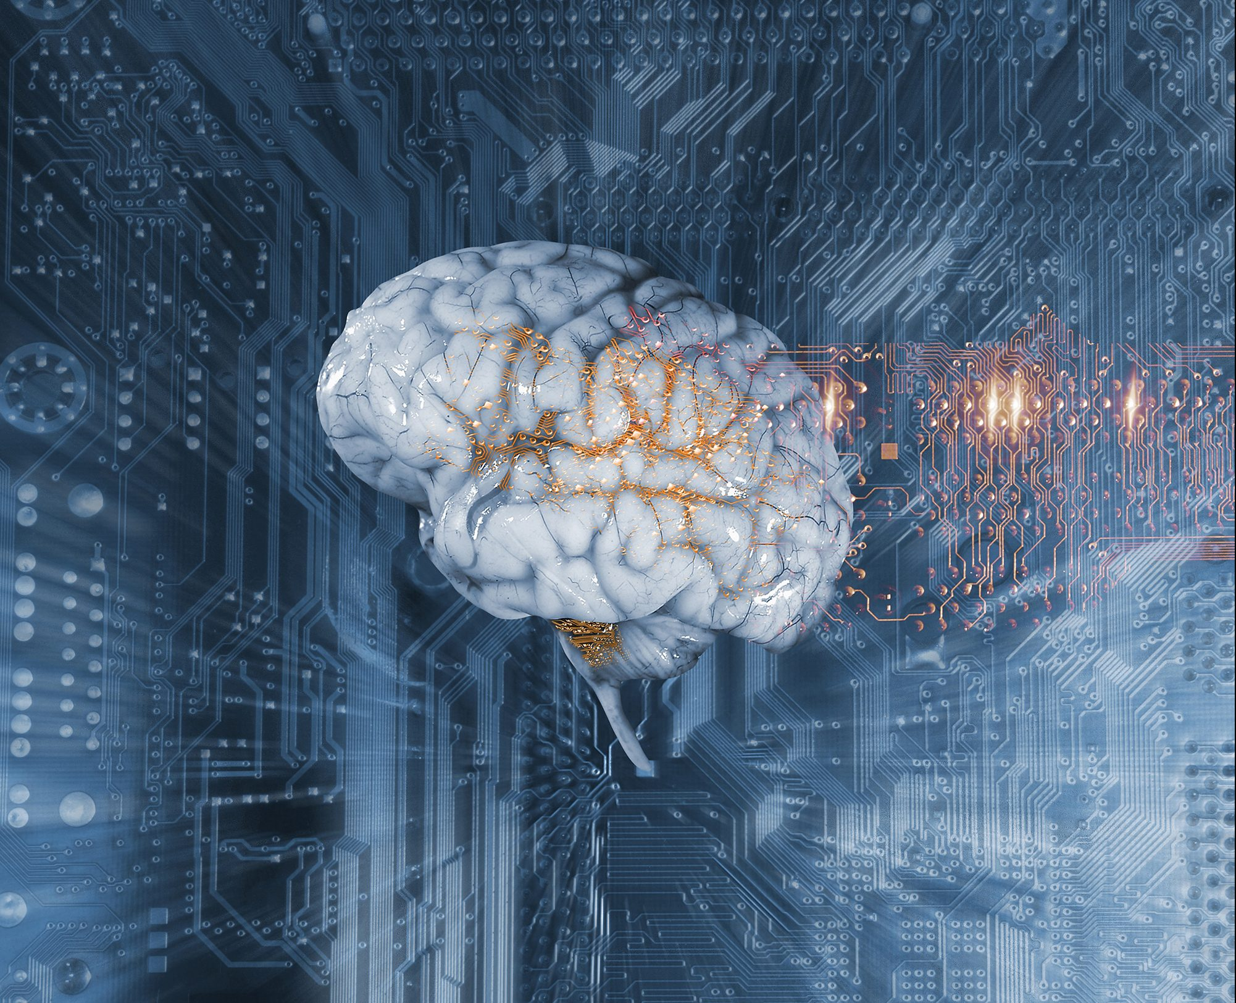
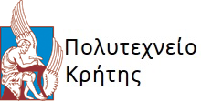
Trimas Christos
Comparison of Artificial Intelligence systems for the detection of objects on UAV-based images.

Slide 2
Contents
What are UAVs?
Object Detection systems.
Convolutional Neural Networks.
Two-stage / single-stage detectors.
RetinaNet.
Modified RetinaNet.
Conclusions.
Limitations and Future Work.

Slide 3
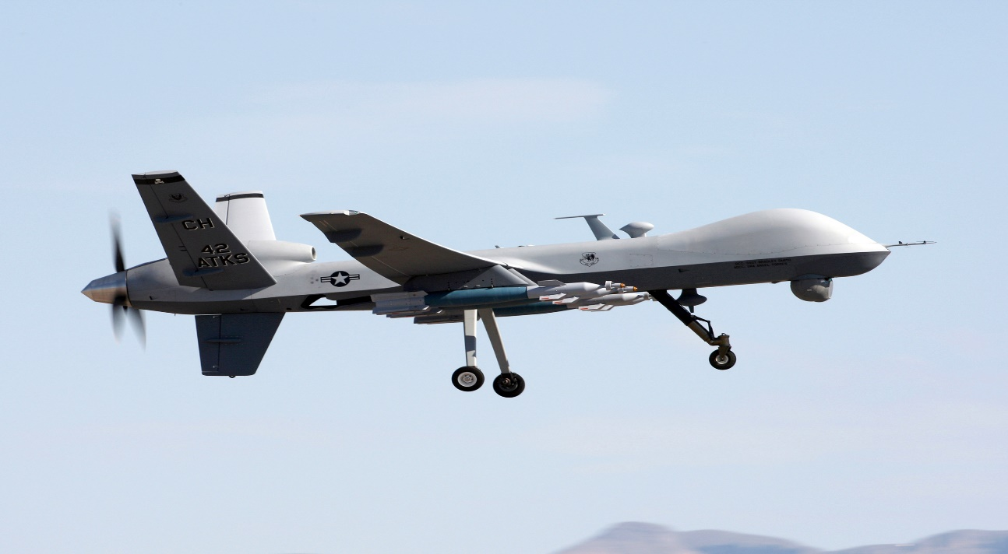
UAVs
Unmanned Aerial Vehicles:
Search and Rescue missions.
Surveillance.
Information gathering.
Object Detection.

Slide 4
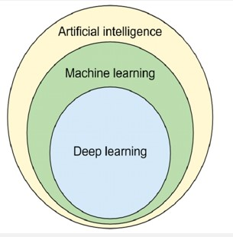
Object Detection
Evolution of Object detection
Better electronics = better cameras.
Artificial Intelligence.
Data Revolution.
Higher Computational Power.

Slide 5
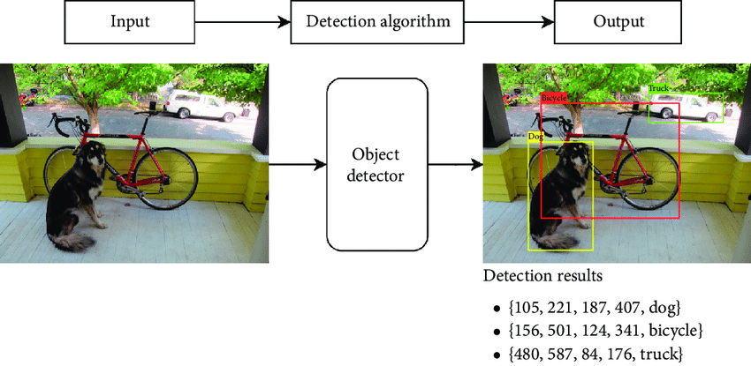
Object Detection
General Idea: Object detection = localization + classification.
Two Stage detectors: First stage generates a sparse set of candidate proposals that should contain all objects while filtering out the majority of negative locations. Second stage classifies the proposals into classes. Well known architectures are R-CNN, Fast/er R-CNN.
Single Stage detectors: Requires a single pass through the Neural Network and predicts all the bounding boxes in one go. They have been tuned for speed, but their accuracy trails that of two stage methods. Well known architectures are YOLO and RetinaNet.

Slide 6
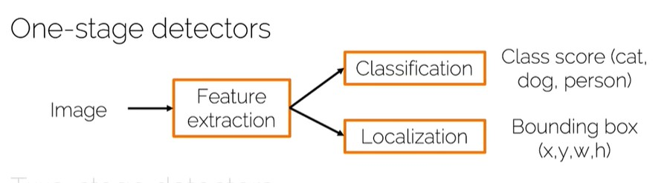
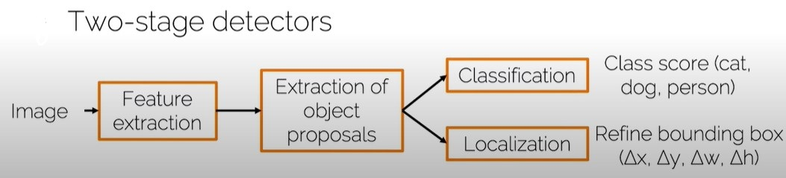
Pipelines

Slide 7
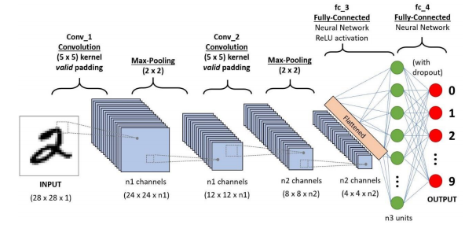
Convolution Neural Networks vs Fully CNN
A typical CNN:
Convolution Layers
Max / Average Pooling Layers
Fully Connected Layers

Slide 8
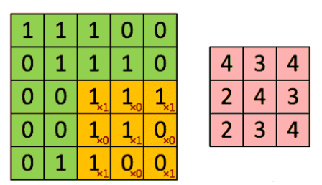
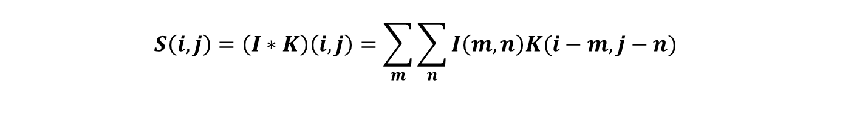
Convolution Layer
Convolution:
$$S\left(i,j\right)=\left(I∗K\right)\left(i,j\right)=\sum_{m}{\sum_{n}{I\left(m,n\right)K(i−m,j−n)}}$$
Goal: Extract high-level semantically rich
features from the input image

Slide 9
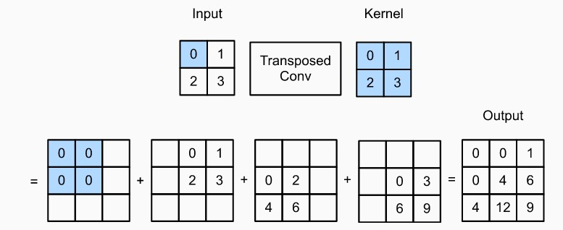
Transpose Convolution
Transpose Convolution:
Goal: to increase (up-sample) the spatial
dimensions of the intermediate feature maps

Slide 10
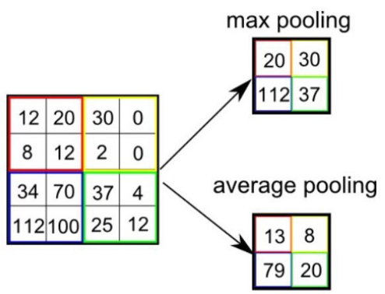
Pooling Layer
Two types: Average and Max Pooling.
Goal: Decrease computational power required to process data.
Extract dominant features through dimensionality reduction.

Slide 11
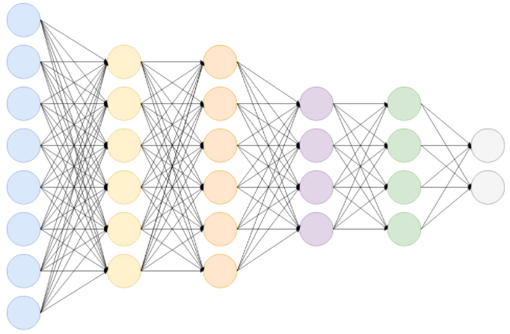
Fully Connected Layers
Cheap way of learning non-linear combinations of the high-level features as represented by the output of the convolution and pooling layers.
Final layer: gets the probabilities and
classifies each input into particular classes.

Slide 12
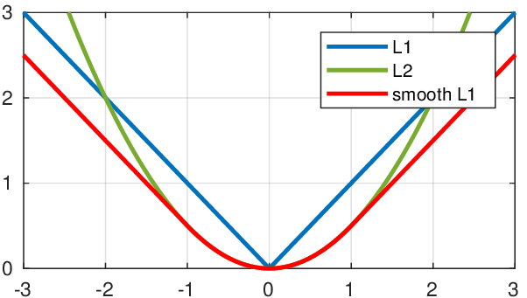
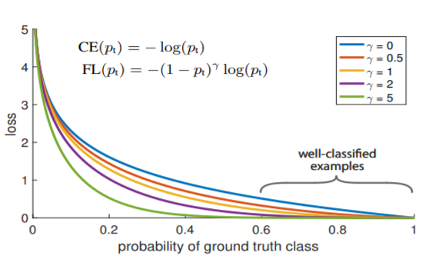
Loss Functions
Loss function : the prediction error of the Artificial Neural Network.
Responsible for the update of the weights of the Neural Network.
$$sL1=\left\{\begin{aligned}\left|x−y\right|, if \left|x−y\right|>a \\ {\frac{1}{\left|a\right|}(x−y)}^{2}, else if \left|x−y\right|≤a\end{aligned}\right.$$
$$FL\left(p_{t}\right)={\left(1−p_{t}\right)}^{γ}log(p_{t})$$

Slide 13
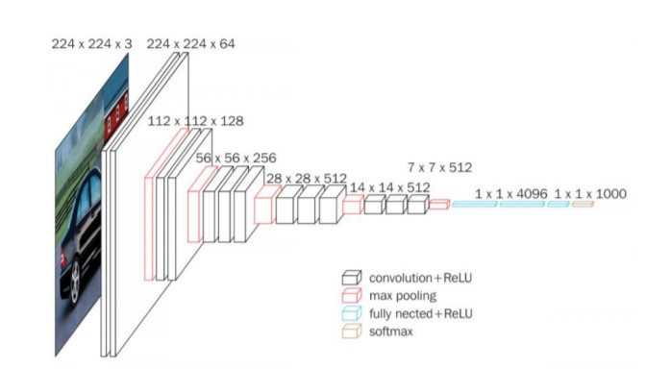
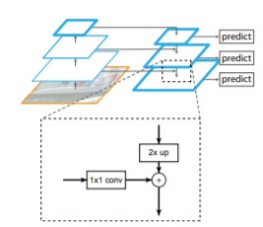
CNNs v Fully CNN
CNNs:
Contains Fully Connected Layers.
Can be used as backbone networks.
ResNet, VGG, etc.
A typical CNN usually contains fully connected layers.
Fully CNNs:
No Fully Connected Layers.
Performs only Convolution, up-sampling and down-sampling operations.
Can handle different input sizes.
Unet, Feature Pyramid Network, etc.

Slide 14
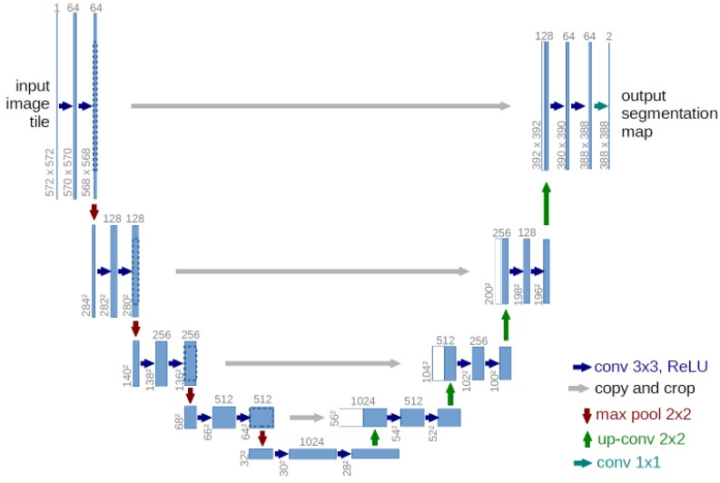
U-Net
UNet
A well known Fully Convolutional Network is the UNet. It is commonly used for semantic segmentation, but its architecture is quite similar to the Feature Pyramid Network.
Top-down pathway: Simple ConvNet consisting of convolutions and max pooling operations.
Bottom-up pathway: “Deconvolution” and convolution operations as well as concatenation to combine high level and low level features.

Slide 15
Feature Pyramid Network
Feature Pyramid Network
Feature Pyramid Network can be used as backbone network for object detection or segmentation. Consists of an “encoder” (bottom-up pathway) and a “decoder” (top-down pathway).
Bottom-up pathway: Usually a ConvNet is used for feature extraction such as VGG or ResNet.
Using lateral connections the output of the ConvNet is fed to the top-down pathway as input.
Top-down pathway: Using up-sample to match the spatial dimensions between the output of two consecutive Convolutional Blocks it adds the outputs in order to create a rich multi scale convolutional pyramid.

Slide 16
FPN v U-Net
FPN vs UNet
Main difference: FPN has multiple prediction layers, one for each upsampling layer.
Both architectures have lateral connections, but Unet only crops and copies the features, while the FPN applies a 1x1 convolution layer before adding them.

Slide 17
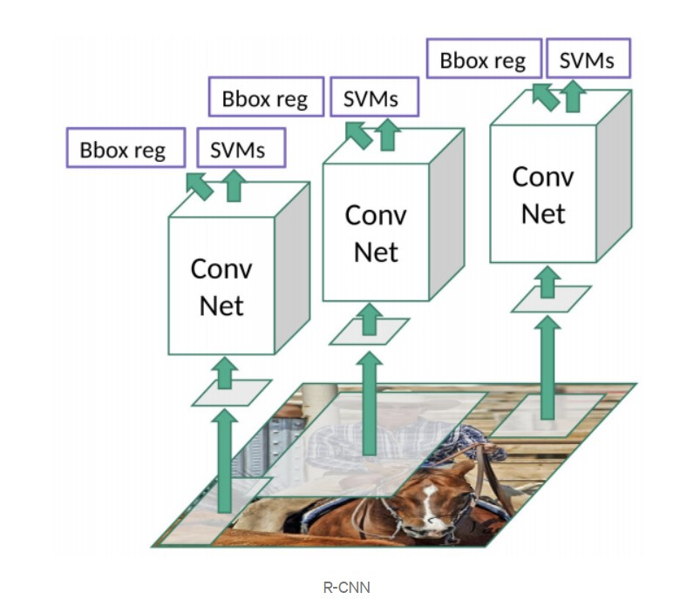
RCNN
R-CNN architecture
RCNN is two stage detector.
1st stage: Analyzes the input image and divides it into regions (bounding boxes). The algorithm that is used is called selective search and produces roughly 2000 regions. Then the images are getting warped for each region, until it gets a fixed size of pixels.
2nd stage: The new images are introduced into the CNN and the output dense layer consists of features that are fed into SVM. In addition, the model predicts four values, which are offset values to increase the precision of the bounding box.

Slide 18
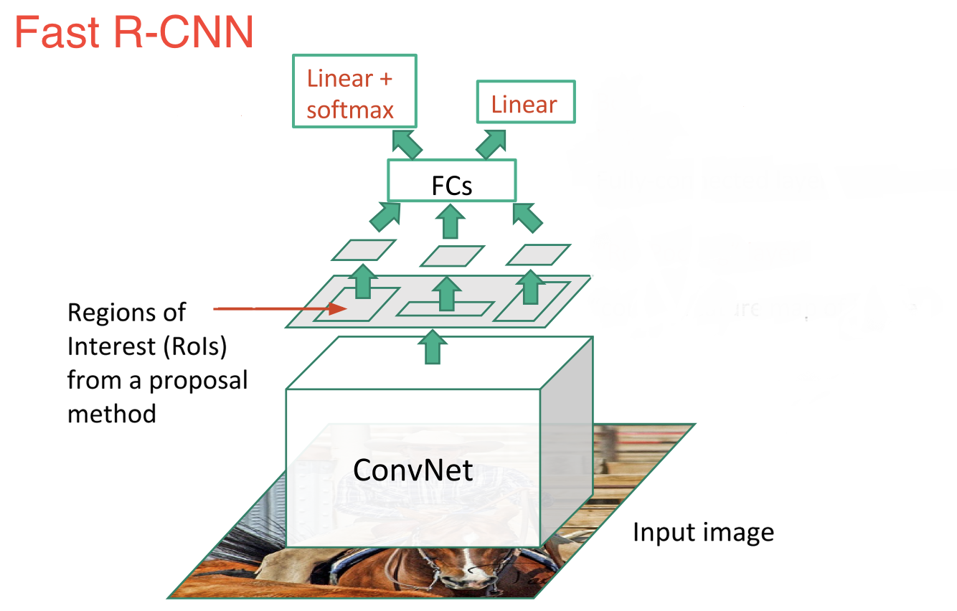
Fast RCNN
Fast R-CNN architecture
Fast RCNN an improvement of R-CNN.
First the image gets fed to a ConvNet. Then the selective search algorithm is used to generate RoIs from the feature map that was created. Afterwards the regions are warped and fed into FCs for classification and bounding box regression.

Slide 19
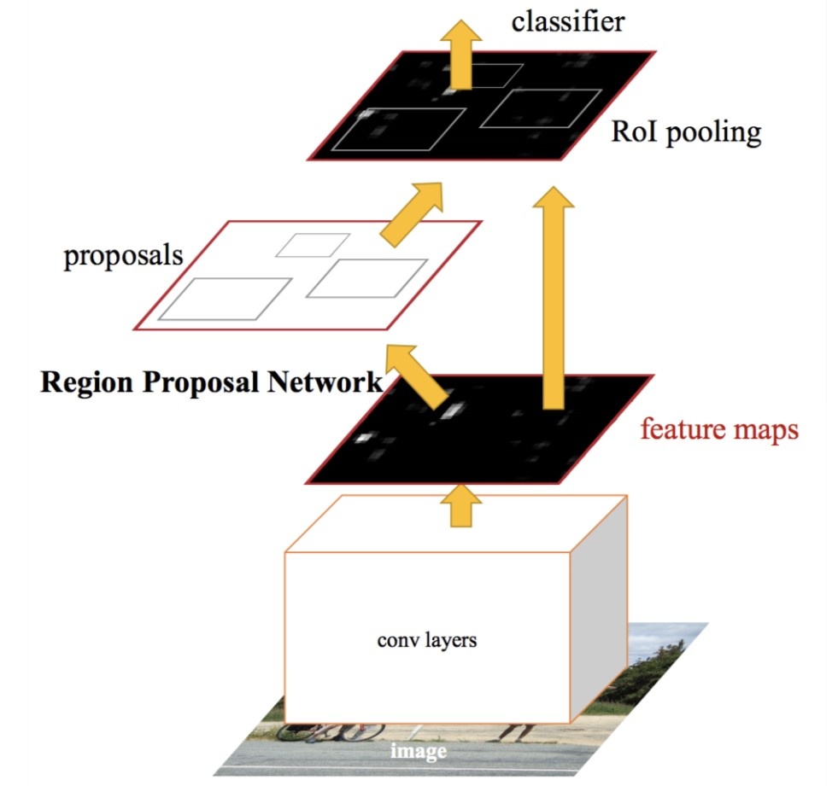
Faster RCNN
Faster R-CNN architecture
Faster RCNN. The input is fed to a ConvNet, then the feature map is fed in to another network called Region Proposal Network. RPN replaces selective search in Faster RCNN. The network gets trained and afterwards the proposals follow the same path as Fast RCNN.

Slide 20
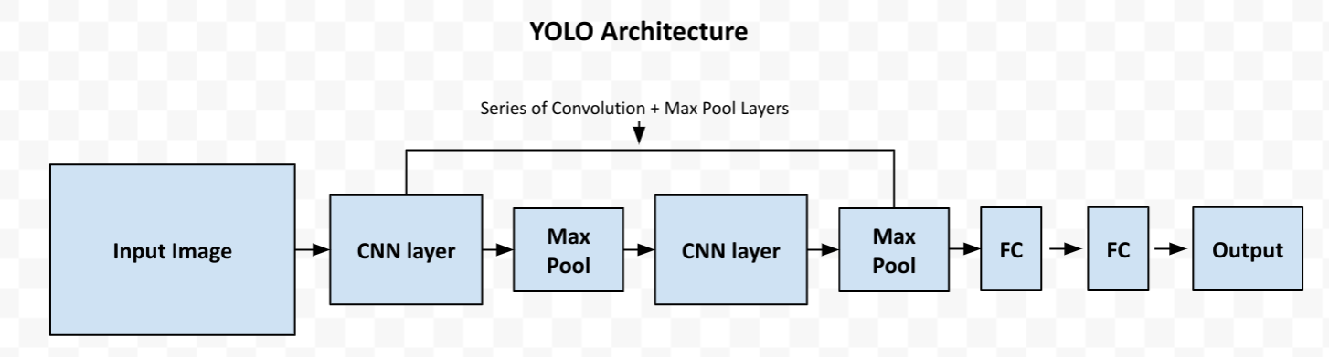
YOLO general Pipeline
YOLO Pipeline
General Architecture of YOLO (Fast, Tiny, v1, v2, etc).

Slide 21
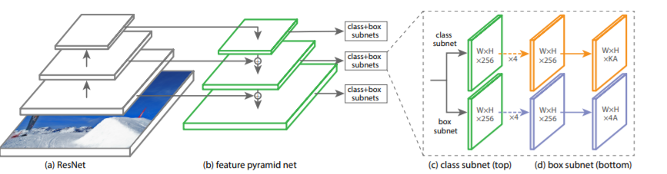
RetinaNet Architecture
RetinaNet Architecture
The one stage RetinaNetwork architecture, uses a Feature Pyramid Network on top of a feedforward ResNet architecture as backbone, in order to generate a rich, multi-scale convolutional feature pyramid.
Two Fully Convolutional Network (top for classification, bottom for box regression) are attached to each FPN level and the parameters of this subnet are shared across all pyramid levels.

Slide 22
Backbone Network
RetinaNet Backbone
The backbone is necessary for computing a convolutional feature map over the entire image. It consists of an encoder (a residual network e.g. ResNet50) and a Feature Pyramid Network.
The original image is applied as an input to the encoder, which processes the image through convolutional kernels and generates deep features.
Our case a ResNet50 is used as encoder(bottom-up pathway).

Slide 23
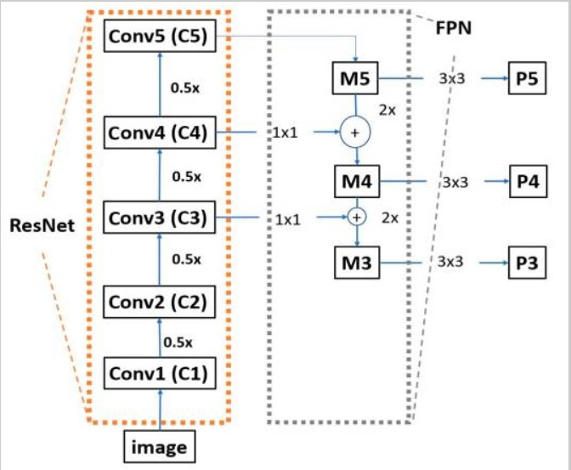
ResNet50 - FPN
ResNet50
Composed of many convolutional layers.
The ResNet50 that RetinaNet utilizes does not contain the last average pooling layer, the fully connected layer and the softmax layer.
Moving from the bottom to the top, the spatial dimensions are reduced by half.

Slide 24
ResNet50 - FPN
FPN
For each feature map, the FPN up-samples the spatial resolution of the input feature map by a factor of two, and the up-sampled map is then merged with the corresponding bottom-up map, which undergoes a 1x1 convolution to reduce channel dimension by element-wise addition.

Slide 25
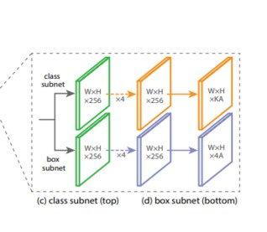
Classification
Classification Net
Predicts the probability of object presence at each spatial position for each of the A anchors and K object classes.
A small FCN attached to each FPN level. Parameters are shared across all pyramids levels.
Design: As input a feature map with C(256) channels from a pyramid lvl. Applies four 3x3 conv layers, each with C filters and followed by ReLU activations, followed by a 3x3 conv layer with KA filters. Last layer, sigmoid activation attached to output the KA predictions per spatial location.

Slide 26
Box Regression
Bounding Box Regression
Identical design, ends in 4A linear outputs per spatial location.
Predicts the relative offset between anchor and the ground truth box.

Slide 27
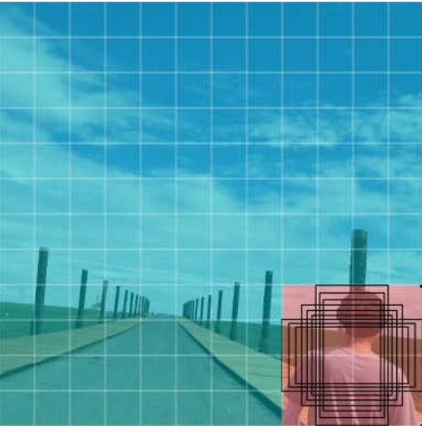
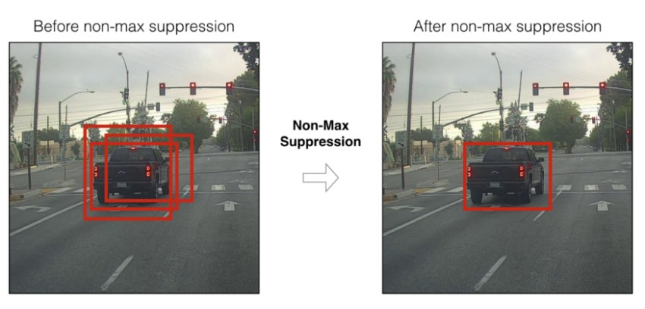
Anchor Boxes
Anchor Boxes
A set of predefined bounding boxes of a certain height and width.
Defined to capture the scale and aspect ratio of specific object classes you want to detect and are typically chosen based on object sizes in the training datasets.
Anchor Boxes Parameters:
sizes = {16, 32, 64, 128, 256}
aspect ratios = {1:2,1:1,2:1,3:1}
(16x32, 16x16, 32x16, 64x16
32x64, 32x32, 64x32, 128x32
64x128, 64x64, 128x64, 256x64
128x256, 128x128, 256x128
256x256)
Total 16 possible anchor boxes.
Non Maximum Suppression is applied to remove overlapping predictions and to get the box with the highest IoU.

Slide 28
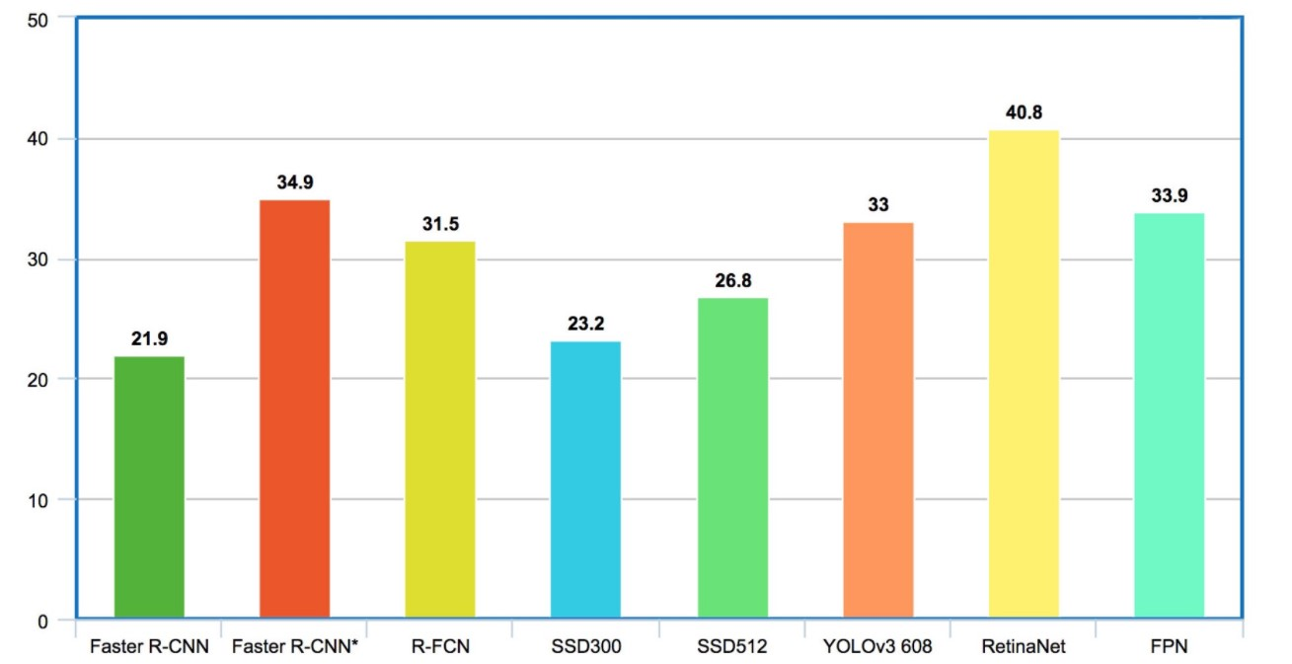
Why Retina?
Why RetinaNet?
Mean Average Precision in the COCO dataset

Slide 29
Data description
Dataset Description
Name: Stanford Drone Dataset.
Training annotations(35.765):
Person (22673)
Biker (11479)
Car (1512)
Bus (101)
Dataset Format: Pascal VOC (path/to/image/, x1, y1, x2, y2, class_name).
Test annotations(6.816):
Person (5558)
Biker (1204)
Car (23)
Bus (31)

Slide 30
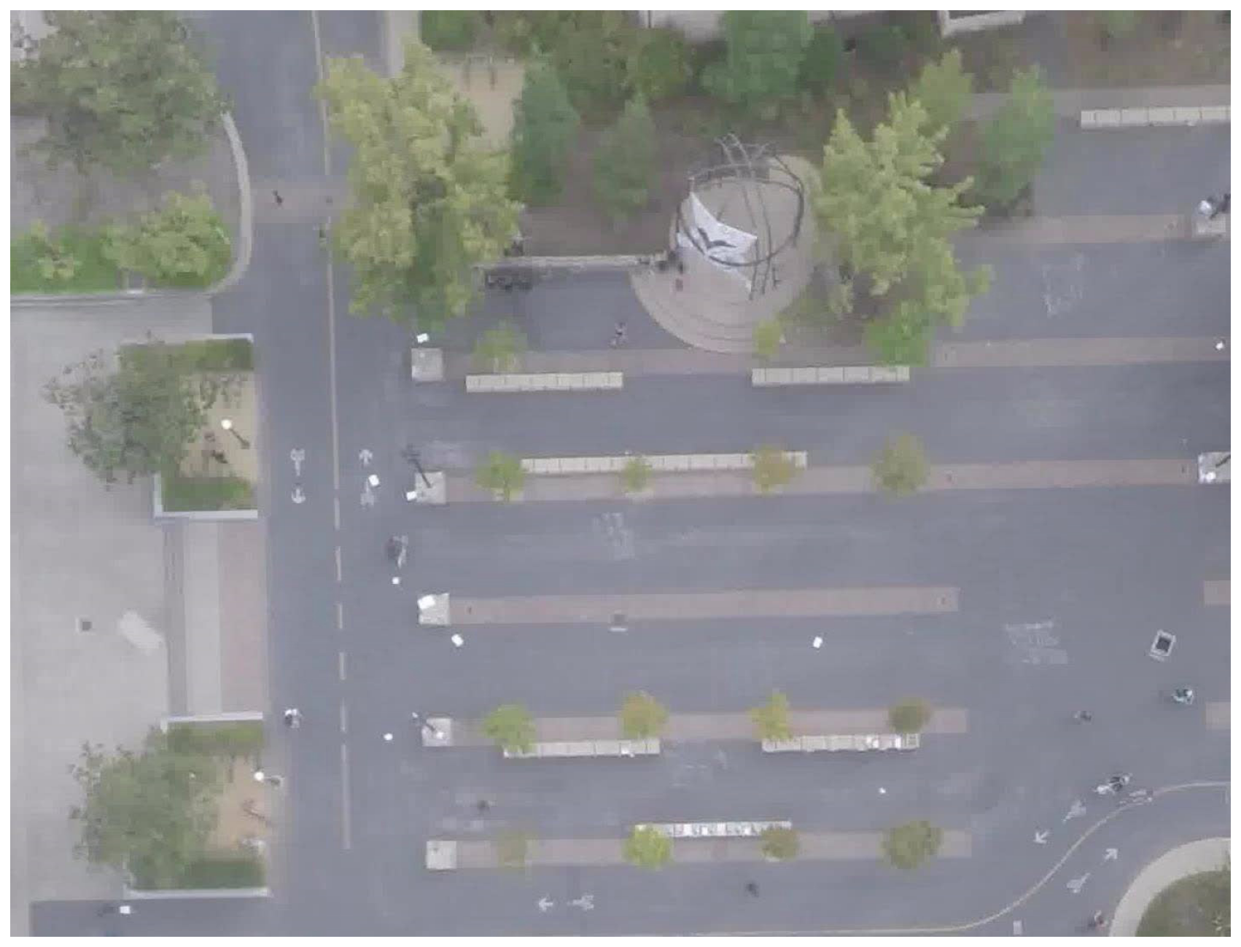
Data description
Image Example

Slide 31
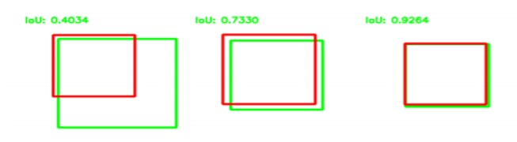
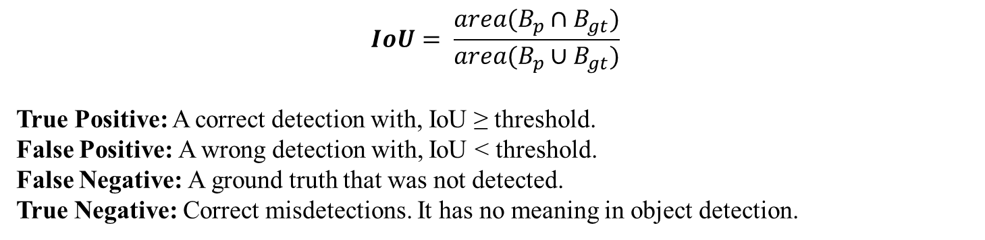
Metrics
Metrics
$$IoU= \frac{area(B_{p}∩B_{gt})}{area(B_{p}∪B_{gt})}$$
True Positive: A correct detection with, IoU ≥ threshold.
False Positive: A wrong detection with, IoU < threshold.
False Negative: A ground truth that was not detected.
True Negative: Correct misdetections. It has no meaning in object detection.

Slide 32
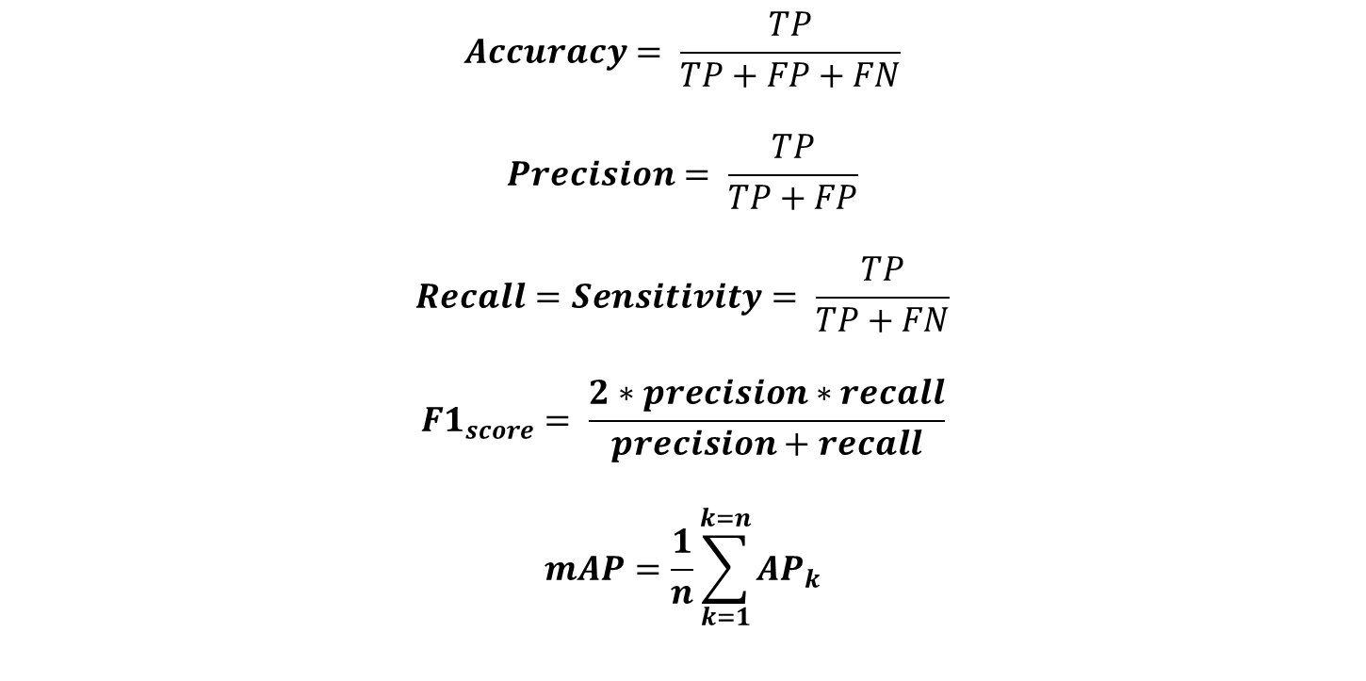
Metrics
Metrics
$$Accuracy= \frac{TP}{TP+FP+FN}$$
$$Precision= \frac{TP}{TP+FP}$$
$$Recall=Sensitivity= \frac{TP}{TP+FN}$$
$$F1_{score}= \frac{2∗precision∗recall}{precision+recall}$$
$$mAP=\frac{1}{n}\sum_{k=1}^{k=n}{{AP}_{k}}$$

Slide 33
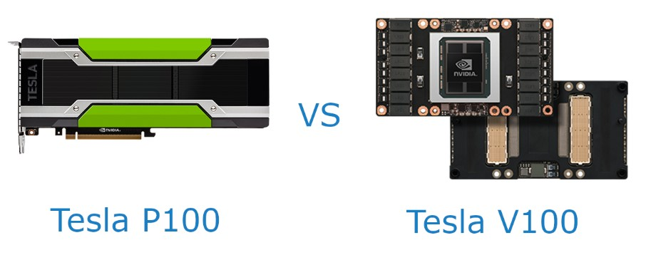
Training Enviroment
Metrics
The training and testing took place in Google Colab. Colab allows anybody to write and execute arbitrary python code through the browser, and is especially well suited to machine learning, data analysis.

Slide 34
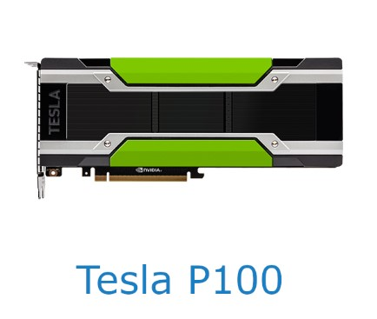
Training Enviroment
Metrics
NVIDIA Pascal architecture.
3.584 CUDA core.
Performs at 4.7 TeraFLOPS.
Memory: 16GB.
Power Consumption: 250W.

Slide 35
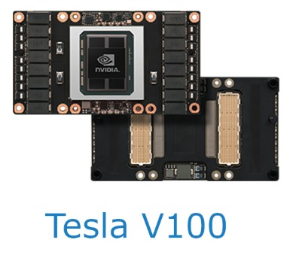
Training Enviroment
Metrics
NVIDIA Volta architecture.
640 Tensor cores / 5.120 CUDA core.
Performs at 7 TeraFLOPS.
Memory: 32GB.
Power Consumption: 250W.

Slide 36
Retina Training/Evaluation
RetinaNet Training/Evaluation
Data Split (Training/Test).
Feed Training annotations to Network.
Training for 100 epochs on NVIDIA Tesla P100.
Test network.
Metric | Simple split (0.6 threshold)
Accuracy | 0.800
Precision | 0.847
Recall | 0.934
F_1 score | 0.889
mAP/wmAP | 0.611/0.870

Slide 37
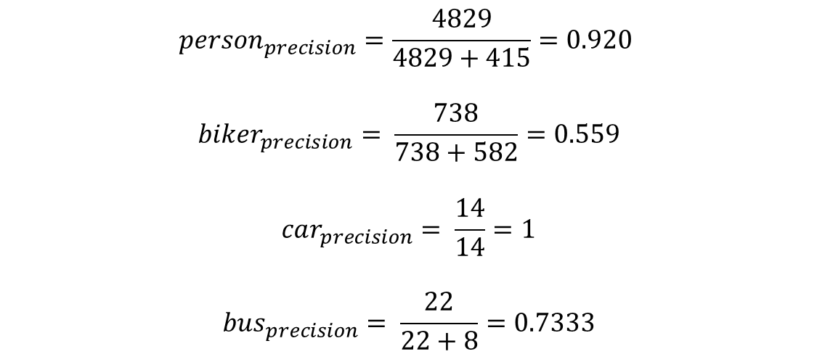
Retina Evaluation
Confusion Matrix
Person | 4829 | 582 | 0 | 0
Biker | 415 | 738 | 0 | 0
Bus | 0 | 0 | 22 | 0
Car | 0 | 0 | 8 | 14
None | 643 | 122 | 1 | 6
 | Person | Biker | Bus | Car
$${person}_{precision}=\frac{4829}{4829+415}=0.920$$
$$biker_{precision}= \frac{738}{738+582}=0.559$$
$$car_{precision}= \frac{14}{14}=1$$
$$bus_{precision}= \frac{22}{22+8}=0.7333$$

Slide 38
Retina Training/Evaluation
RetinaNet Training/Evaluation
Metric | Simple split (0.7 threshold)
Accuracy | 0.746
Precision | 0.776
Recall | 0.950
F_1 score | 0.854
mAP/wmAP | 0.596/0.847

Slide 39
Retina Evaluation
Confusion Matrix
Person | 4661 | 898 | 0 | 0
Biker | 630 | 661 | 0 | 0
Bus | 0 | 0 | 25 | 0
Car | 0 | 0 | 6 | 17
None | 207 | 67 | 1 | 6
 | Person | Biker | Bus | Car

Slide 40
K-fold Cross Validation
5-fold Cross Validation
Split Data (Training/Test).
Split Training Data (Training/ Validation)
Feed Training Data in the Network.
Training 90 epochs.
Test in the Validation Data.
Repeat 5 times total.
Test each model in the Test set.
Obtain a mean average from the 5-fold cross validation.
 | 1st fold | 1st fold | 2nd fold | 2nd fold | 3rd fold | 3rd fold | 4th fold | 4th fold | 5th fold | 5th fold | mean | mean
Accuracy | 0.795 | 0.789 | 0.792 | 0.748 | 0.584 | 0.657 | 0.689 | 0.742 | 0.821 | 0.796 | 0.736 | 0.746
Precision | 0.865 | 0.857 | 0.866 | 0.853 | 0.818 | 0.849 | 0.841 | 0.859 | 0.853 | 0.852 | 0.848 | 0.854
Recall | 0.908 | 0.899 | 0.902 | 0.900 | 0.670 | 0.655 | 0.792 | 0.788 | 0.955 | 0.943 | 0.845 | 0.837
F_1 score | 0.886 | 0.888 | 0.883 | 0.886 | 0.737 | 0.711 | 0.816 | 0.817 | 0.897 | 0.901 | 0.843 | 0.840
 | Val | Test | Val | Test | Val | Test | Val | Test | Val | Test | Val | Test

Slide 41
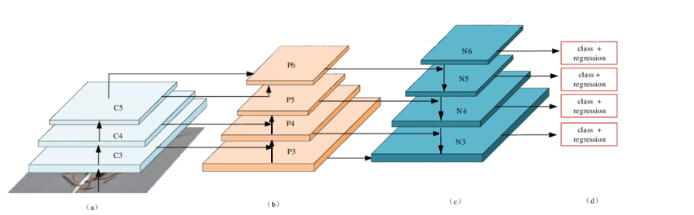
Modified RetinaNet Architecture
RetinaNet Architecture
Almost same architecture.
Extra Convolution block.
Extra convolution layers.

Slide 42
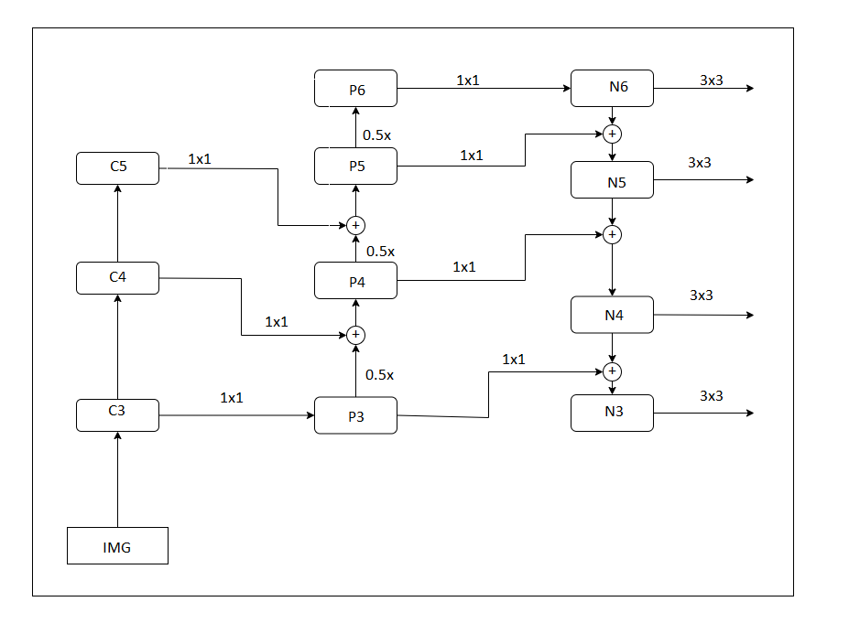
Modified RetinaNet Architecture
RetinaNet Architecture

Slide 43
Modified RetinaNet Evaluation
RetinaNet Architecture
Metric | Simple split (0.6 threshold)
Accuracy | 0.849
Precision | 0.887
Recall | 0.943
F_1 score | 0.914
mAP/wmAP | 0.632/0.897

Slide 44
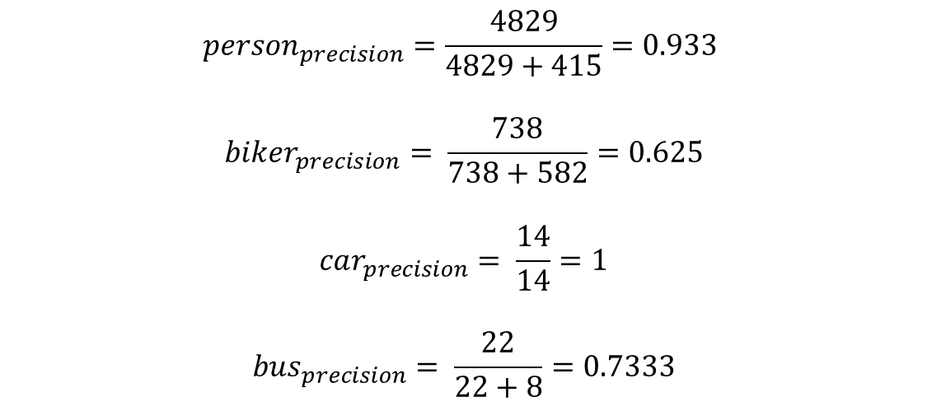
Modified Retina Evaluation
Confusion Matrix
Person | 4972 | 504 | 0 | 0
Biker | 355 | 842 | 0 | 0
Bus | 0 | 0 | 22 | 0
Car | 0 | 0 | 8 | 14
None | 397 | 192 | 1 | 6
 | Person | Biker | Bus | Car
$${person}_{precision}=\frac{4829}{4829+415}=0.933$$
$$biker_{precision}= \frac{738}{738+582}=0.625$$
$$car_{precision}= \frac{14}{14}=1$$
$$bus_{precision}= \frac{22}{22+8}=0.7333$$

Slide 45
Modified Retina Evaluation
Confusion Matrix
 | 1st fold |  | 2nd fold |  | 3rd fold |  | 4th fold |  | 5th fold |  | Mean
Accuracy | 0.811 | 0.808 | 0.776 | 0.756 | 0.603 | 0.688 | 0.749 | 0.777 | 0.860 | 0.819 | 0.759 | 0.770
Precision | 0.887 | 0.846 | 0.844 | 0.877 | 0.834 | 0.854 | 0.866 | 0.898 | 0.901 | 0.875 | 0.866 | 0.870
Recall | 0.912 | 0.901 | 0.909 | 0.920 | 0.705 | 0.703 | 0.819 | 0.800 | 0.963 | 0.966 | 0.861 | 0.858
F_1 score | 0.899 | 0.873 | 0.875 | 0.897 | 0.764 | 0.771 | 0.841 | 0.846 | 0.930 | 0.918 | 0.861 | 0.861
 | Val | Test | Val | Test | Val | Test | Val | Test | Val | Test | Val | Test

Slide 46
Modified v Original Retina
Metrics
Significant more time to train the model.
Accuracy 6% higher than original.
Precision 4% higher than the original.
Recall 1% higher than the original.
F1 score 2% higher than the original.
Mean Average Precision and weighted mAP higher than the original.

Slide 47
Comparison to other models
Metrics
Model | mAP(%)
FasterRCNN | 59.60
SSD | 64.31
YOLOv3 | 57.42
RetinaNet | 61.10
Modified Retina | 63.27

Slide 48
Conclusions
Metrics
Modified Retina outperformed most of the detectors.
Single Shot Detector performed slightly better in terms of mAP.
Modified architecture performed better than baseline model.
Ideal for detection of small objects that require high accuracy score.

Slide 49
Limitations / Future Work
Metrics
Limitations:
Required high computational power.
Limited Access to Colab resources.
Long hours of training.
Future work:
Train model with other loss functions.
Better fine tuning of the network.
Data fusion to enlarge the dataset.

Slide 50
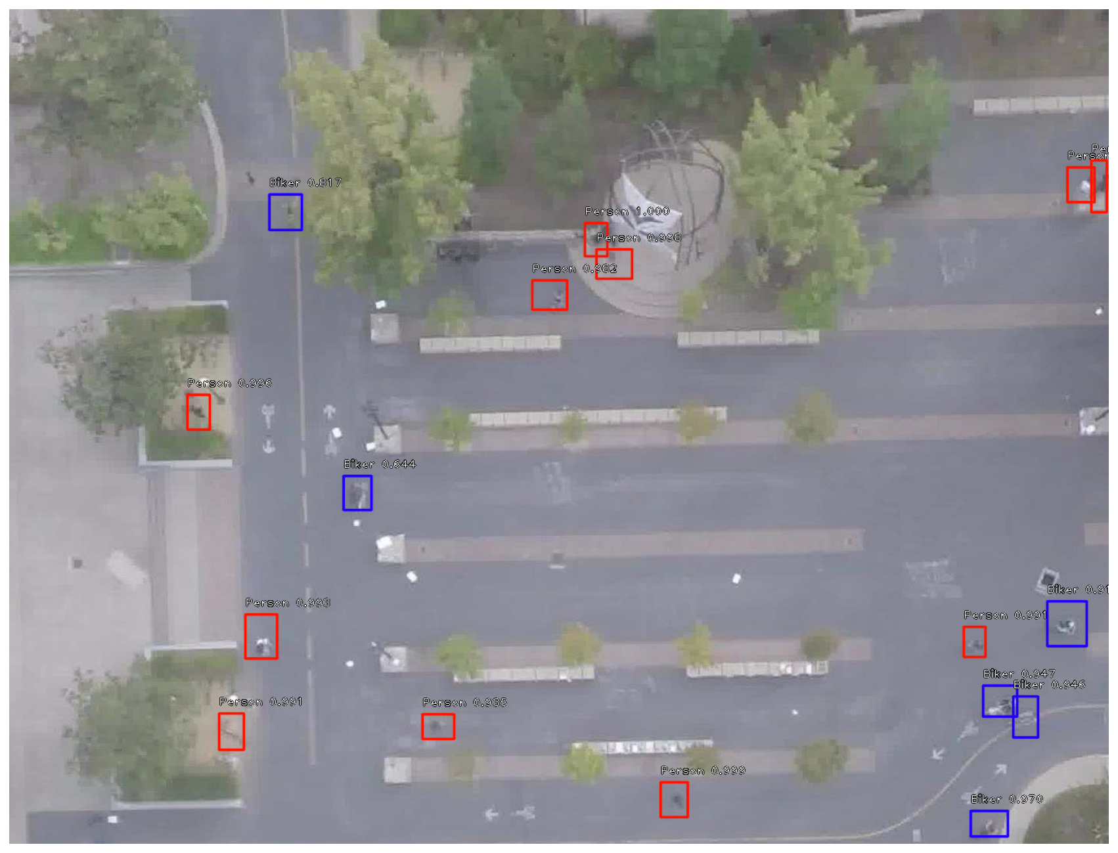
Detections

